Slide 1


Exploring Measurement Table
as an alternation of the genomic-cdm
2020-03-31
Seojeong Shin, Seng Chan You
Notes:
Hi, I’ll present how we can utilize the measurement table for storing genomic data.
I told you several times, but this time, it’s kind of summary.

Slide 2
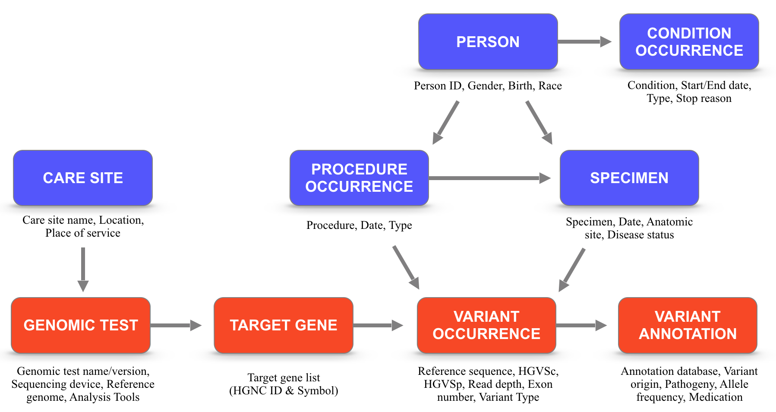
Genomic-CDM
Next Generation
Sequencing (NGS)
[Clinvar] Pathogenic
p.Leu858Arg
[PolyPhen] Damaging
Exon19 Deletion
[SIFT] Deleterious
EGFR
[GNOMAD] 0.686792
p.Thr790Met
KRAS
BRAF
Notes:
The first version of the proposed genomic-cdm was designed under the consideration of the genomic test process.
The genomic-cdm composed with the information of device, panel, targeted gene list, analysis software, parameters, quality scores, variants, and clinical impact.

Slide 3
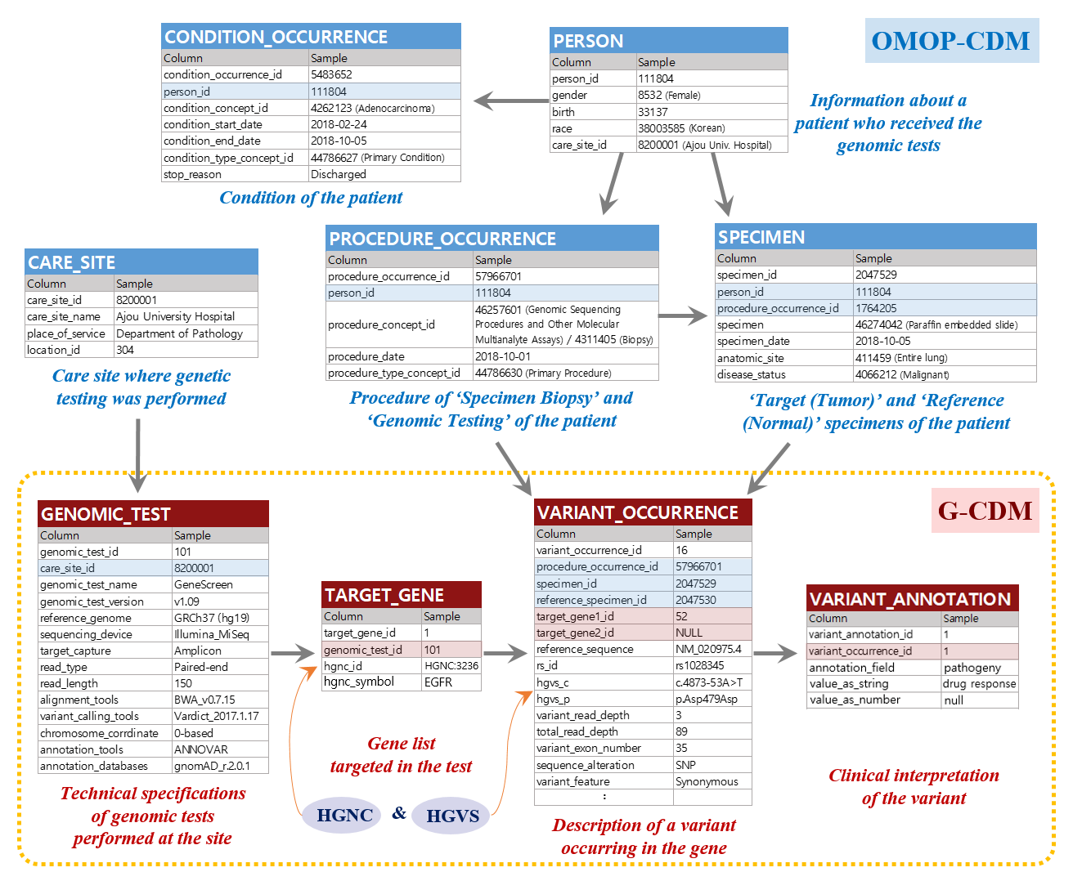
(1)
(2)
(4)
(5)
(3)
(8)
(6)
(7)
(9)
Notes:
These four genomic tables are connected to other tables of omop-cdm for interoperating clinical information.

Slide 4
Need to create or adopt
ID and variant voca. system
Unique ID & Source_value
of Gene+Variant Combi.
Notes:
But if we just use the measurement table instead, we can use the table like this.
Let me explain under the assumption that we have already created or found concepts about the combination of gene and variant.
The source_value of the combination of gene and variant goes into value_source_value column.
And their concept_id goes into the measurement_concept_id column, which we will use in PLP analysis scripts.

Slide 5
Need to create ID
Need to create or adopt
ID and variant voca. system
Sequencing Types
Unique ID & Source_value
of Gene+Variant Combi.
1) Sanger Sequencing
2) NGS Gene Panel
3) Exome Sequencing
4) Genome Sequencing
Notes:
We can easily select the rows which are related to sequencing results by checking these columns.
In the measurement_type_concept_id column, we can store the concept_id about NGS Gene Panel.

Slide 6
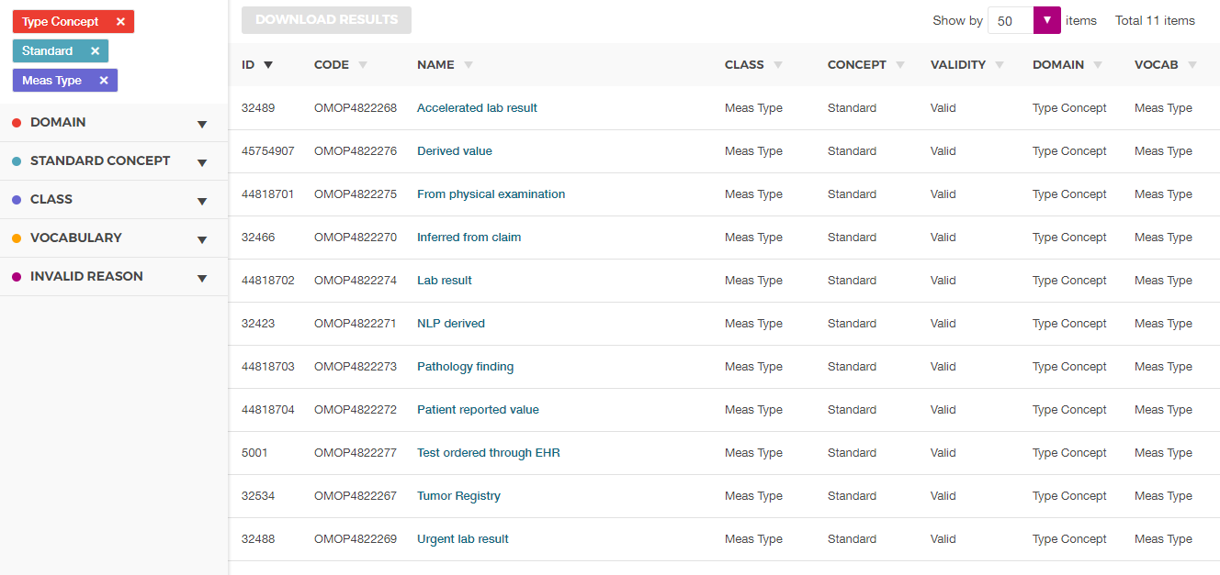
5023928
(new ID)
Genomic Sequencing
Meas Type
Standard
Valid
Type Concept
Meas Type
Notes:
We only have concept name for ‘lab result’ so far. If we need, we can consider to create new concept for genomic sequencing.

Slide 7
Need to create ID
Need to create or adopt
ID and variant voca. system
Sequencing Types
Unique ID & Source_value
of Gene+Variant Combi.
1) Sanger Sequencing
2) NGS Gene Panel
3) Exome Sequencing
4) Genome Sequencing
Copy number
in CNV type variant
“Positive”
※ Issues in using Measurement Table
Have to modify PLP script
Can’t store the ‘negative’ result
Information Loss: Device, Panel (target gene list), Analysis Software, Parameters, Quality scores, Clinical impact, etc.
Notes:
There are three types in variant roughly. It’s SNP, Fusion, and CNV.
Especially for CNV, we need to express how many they were increased.
The value of copy number goes into the value_as_number column.
In the other types, just remain the cell empty.
And for the value_as_concept_id column, we can fill the cells with the text ‘Positive’ even we would not store negative results.

Slide 8
End of the document

Slide 9
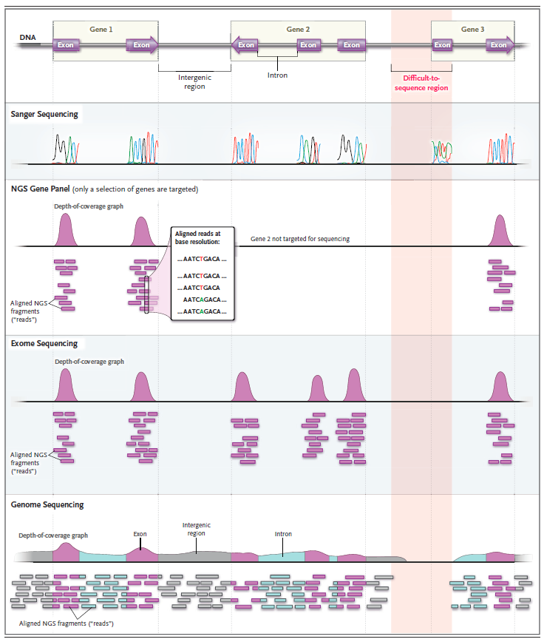
Sequencing
Measurement _concept_id | Measurement_type _concept_id
1004001 | 5023928
1004002 | 5023928
1004003 | 5023928
1004004 | 5023928
5023928 (Genomic Sequencing)
1004001 (Sanger Sequencing)
1004002 (NGS Gene Panel)
1004003 (Exome Sequencing)
1004004 (Genome Sequencing)
Notes:
There are about four types of sequencing related to their range of targeting.
If we create concepts for those types, we can distinguish the row of the result of the cancer panel test.

Slide 10
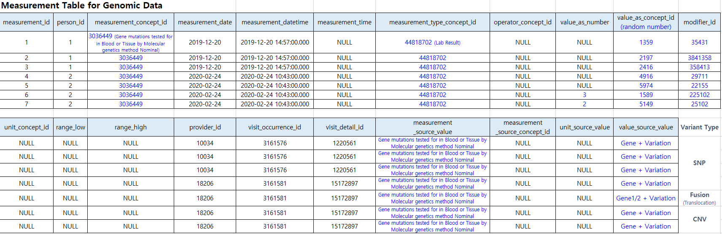
Notes:
As I explained in our meeting two weeks ago, when we use the measurement table for storing genomic data, this is an example of measurement table to store variants.

Slide 11
Minimized Genomic-CDM
 |  |  | SNP | CNV | TRA | Negative
# | Field | Description | Example | Example | Example | Example
1 | genomic_id | A unique identifier for each variant occurrence event | 7 | 8 | 9 | 10
 | person_id |  | 10561 | 10561 | 10561 | 10561
2 | procedure_id | A foreign key identifier to the Procedure_occurrence table for the procedure used to obtain the specimen | 468137 | 468137 | 468137 | 468137
3 | specimen_id | Tumor specimen ID | 1356798 | 1356798 | 1356798 | 1356798
5 | gene1 | A foreign key identifier to the Target_gene table for which the variant information is recorded | HGNC:3236 | HGNC:3236 | HGNC:3236 | HGNC:6915
7 | gene2 | A foreign key identifier to the Target_gene table for which the variant information is recorded when a translocation variant occurs | NA | NA | HGNC:6407 | NA
13 | HGVSc | Nomenclature for the sequence variant at the DNA level | c.34G>C | NA | NA | NA
14 | Protein change | Nomenclature for the sequence variant at the protein level | p.Gly12Arg | NA | t(1;20)(NM_002022.2:Met1_Arg417;NM_003286.2:Ile651_Ter766) | NA
17 | copy_number | Copy number value for CNV data | NA | 3 | NA | NA
18 | fusion_breakpoint | sequential position that fusion variant occurred | NA | NA | Chr7:17130882 | NA
19 | fusion_supporting_reads | Supporting read count of the fusion | NA | NA | Chr8:34975033 | NA
20 | consequences | Structural variant type | Insertion | CNV | TRA | Negative
21 | variant_type | Functional variant type | Missense | Amplification | Fusion | Negative
22 | clinvar_significant | Categories or database name of annotation | Pathogenic | Likely_pathogenic | Benign | NA

